Slide 1
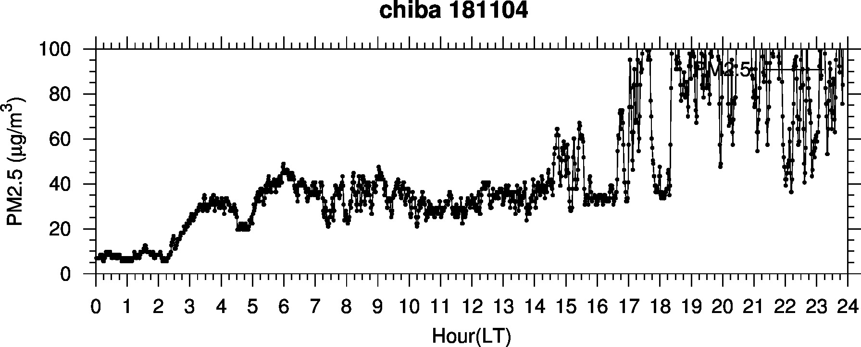
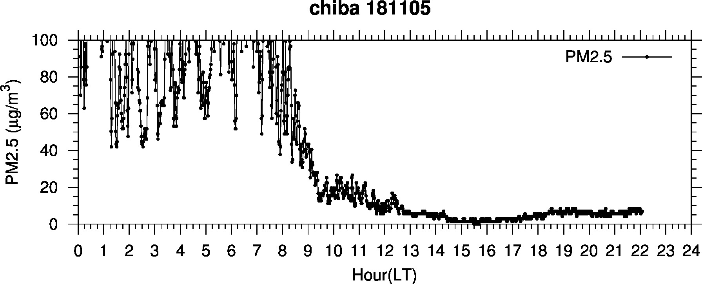
Very high PM2.5 event
from night of Nov. 4 to morning of Nov. 5

Slide 2
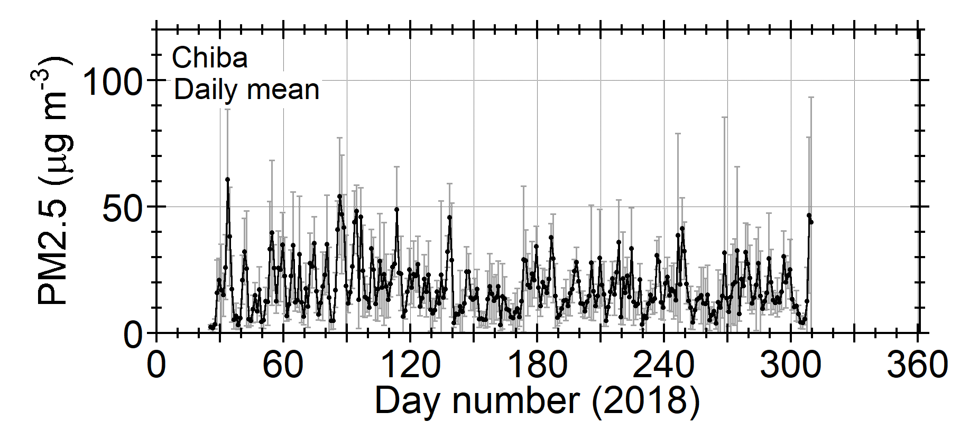
Nov. 4 and 5 were one of
the highest-PM2.5 days in 2018

Slide 3
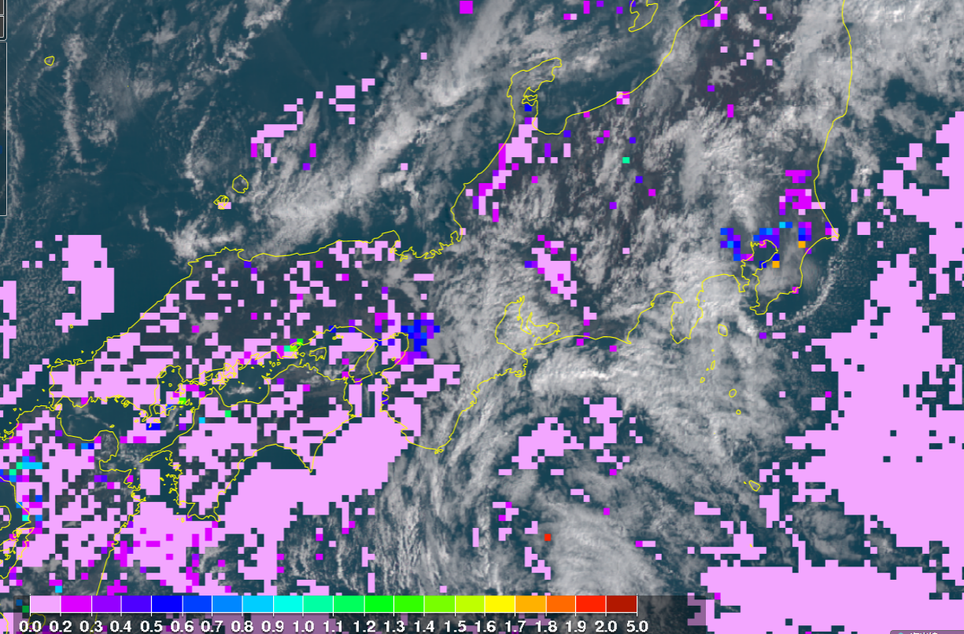
AOT data from JAXA Himawari Monitor
20181105 9:20-29 JST
AOT data from JAXA Himawari monitor

